Slide 1



Name:
Key Stage:
Autumn Term 2024
Communication:
You need to:
Use clear simple instructions, say my name before talking to me, using signs, symbols, pictures and objects
I use: PECS, visual clues such as signs, symbols, pictures and objects, guiding an adults to show them what I want
My Needs | Include SEND summary from EHCP Student A has been diagnosed with autism spectrum disorder (ASD). They can experience difficulties regulating their emotions. Student A finds interacting and playing with other children particularly difficult.
Things that help me: | Include interventions/additional support e.g Multi-sensory curriculum Bucket therapy Classroom schedules PECS Occupational Therapy plan Individualise workstation, resources, and equipment Sensory outdoor play Sensory room Intensive interaction Intimate care needs met with individual plan Low arousal classroom Zone of regulation SALT Intervention TEACCH Now and Next board

Slide 2


My Aspirations
Future Aspirations: | Include hopes for the future (pupil and family wishes) To develop my independent skills and access educational opportunities To communicate my wants and needs To lead an independent life and be able to access the community safely To interact with my peers
Next Steps: | Include details of transition/preparation/work towards goals etc e.g. Futures, college applications, tasters To communicate using signs, symbols and PECS To develop independent skills such as hand washing To transition around school safely

Slide 3
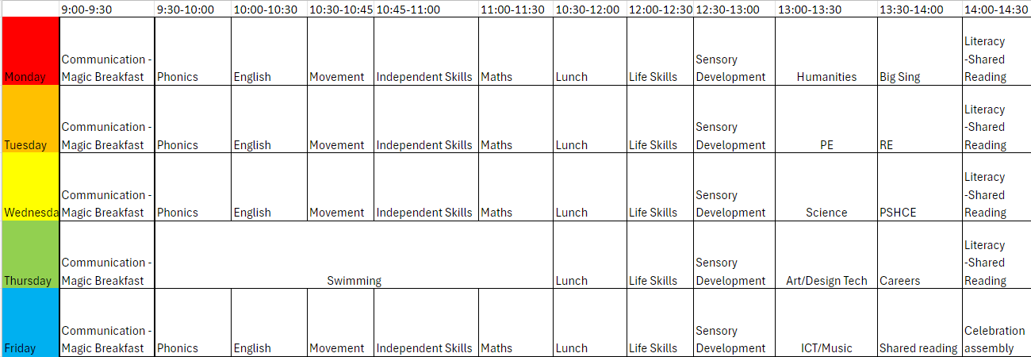
My Timetable

Slide 4
My Progress
Assessment | Attendance 100%
Subject | June 23 | Dec 23 | Mar 24 | Jun 24
Exploration | 84% Step 3 | 84% Step 3 | Step 3 88% | Step 3 89%
Realisation | 86% Step 3 | 86% Step 3 | Step 3 89% | Step 4 54%
Anticipation | 28% Step 4 | 32% Step 4 | Step 4 48% | Step 4 53%
Persistence | 35% Step 4 | 38% Step 4 | Step 4 54% | Step 4 62%
Initiation | 91% Step 3 | 42% Step 4 | Step 4 65% | Step 4 65%
Expressive communication | 79% Step 3 | 79% Step 3 | Step 3 88% | Step 3 88%
Receptive communication | 71% Step 3 | 71% Step 3 | Step 3 77% | Step 3 77%
Social Affection | 79% step 3 | 79% Step 3 | Step 3 88% | Step 3 88%
Emotional Affection | 15% Step 4 | 18% Step 4 | Step 4 56% | Step 4 56%

Slide 5
Assessment | Attendance 100%
Subject | Jun 23 | Dec 23 | Mar 24 | Jun 24
Auditory | 67% Step 3 | 67% Step 3 | Step 3 72% | Step 3 72%
Olfactory/Gustatory operation | 76% Step 3 | 81% step 3 | Step 3 86% | Step 3 86%
Proprioceptive Operation | 69% Step 4 | 72% step 4 | Step 4 76% | Step 4 76%
Tactile Operation | 57% Step 4 | 61% step 4 | Step 4 78% | Step 4 83%
Visual Operation | 83% Step 3 | 83% Step 3 | Step 3 83% | Step 4 23%
Vestibular Operation | 89% Step 4 | 89% Step 4 | Step 4 89% | Step 4 89%
Fine Motor | 73% Step 3 | 73% Step 3 | Step 3 82% | Step 4 86%
Gross Motor | 73% Step 4 | 73% Step 4 | Step 4 82% | Step 4 83%

Slide 6

A
My Personal Learning Goals
Communication Goals:
Student A will sign ‘more’ during bucket time
Safety Goals:
Student A will transition to the dinner hall at lunch time walking safely next to a familiar adult holding their hand
Aspirations:
To communicate my wants and needs
To interact with my peers
To develop my independence skills
Independence Goals:
Student A will independently put their shoes on when they go outside.
Wellbeing Goals:
Student A will engage in a simple turn taking activity with a familiar adult while remaining regulated when waiting for their turn.

